Slide 1
CODEFORGE BUILDX 2026
SHAREPLATE
Share Food. Spread Kindness. Reduce Waste.
A web-based platform connecting surplus-food donors with people and communities in need.
MINI PROJECT PRESENTATION
TEAM
Anusha Saladi • Ramoju Surya Venkata Sai Prakash
Santha Thanuja • Kosuri Teja Sampath Vinay
Department of Computer Science and Engineering
Second Year | Academic Year 2026–2027
ADITYA UNIVERSITY

Slide 2
The Problem
01 • CONTEXT
Food wastage
Access and coordination gap
Surplus food from households, restaurants, events and food businesses may be discarded even when it is still suitable for consumption.
People and community groups may struggle to find available food. Manual communication makes quantities, decisions and collection difficult to coordinate.
THE CORE GAP
Donors and recipients need a shared, organized place to discover food and coordinate requests.
SharePlate addresses the coordination problem. It does not independently certify food safety.
SHAREPLATE • CODEFORGE BUILDX 2026
02 / 12

Slide 3
Proposed Solution & Objectives
02 • APPROACH
A single role-based web platform for publishing surplus food, requesting quantities and tracking donation activity.
Publish
Discover
Request
Allow donors to create and manage surplus-food listings.
Help recipients browse available donations.
Enable quantity-based food requests.
Decide
Track
Promote
Allow donors to approve or reject requests.
Maintain request status and donation history.
Encourage food redistribution and responsible food use.
SHAREPLATE • CODEFORGE BUILDX 2026
03 / 12

Slide 4
Technology Stack
03 • TOOLS
Frontend
UI styling
React.js
Reusable interface components and interactive pages.
Tailwind CSS
Utility-based styling and responsive layouts.
Backend
Database
Python + FastAPI
Server-side logic and REST API endpoints.
PostgreSQL
Persistent storage for users, listings and requests.
ORM
Authentication
SQLAlchemy
Maps application objects to relational tables.
JWT
Token-based authentication for protected operations.
Migrations
Testing / VCS
Alembic
Manages database schema changes.
Pytest • Git • GitHub
Backend tests, source tracking and team collaboration.
SHAREPLATE • CODEFORGE BUILDX 2026
04 / 12

Slide 5
System Architecture
04 • DESIGN
Three-layer client-server architecture
PRESENTATION LAYER
APPLICATION LAYER
DATA LAYER
React.js
Tailwind CSS
Python FastAPI
Validation • API • Business Logic
PostgreSQL
SQLAlchemy • Alembic
Request flow
Browser action → API request → validation and business logic → database operation → API response → updated interface
The backend checks input and access rules before reading or updating PostgreSQL.
SHAREPLATE • CODEFORGE BUILDX 2026
05 / 12

Slide 6
Main Application Workflow
05 • PROCESS
1
Register / Sign in
2
Role-based dashboard
3
Donor publishes food
6
Donor approves / rejects
5
Recipient requests quantity
4
Recipient browses
7
Status and history updated
Donor and recipient actions remain separated by role and access rules.
SHAREPLATE • CODEFORGE BUILDX 2026
06 / 12

Slide 7
Features & Functional Modules
06 • CAPABILITIES
Authentication
Donor dashboard
Registration, login and role-based access.
Create listings, manage donations and review requests.
Food listing
Recipient discovery
Food name, description, category, quantity, image and pickup details.
Browse and search available food listings.
Request management
Tracking & history
Submit required quantity; donor approves or rejects.
View donation/request status and previous activity.
Responsive UI
Food images and layouts for different screen sizes.
SHAREPLATE • CODEFORGE BUILDX 2026
07 / 12

Slide 8
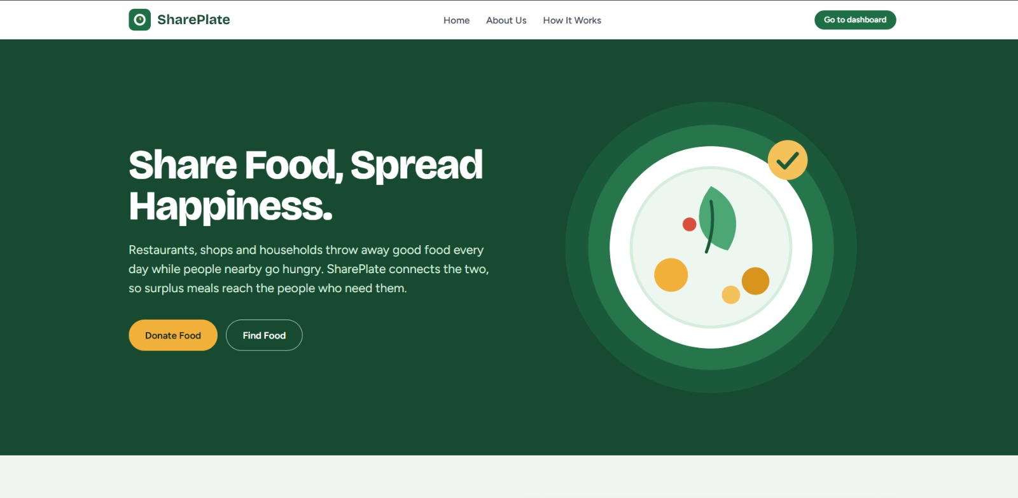
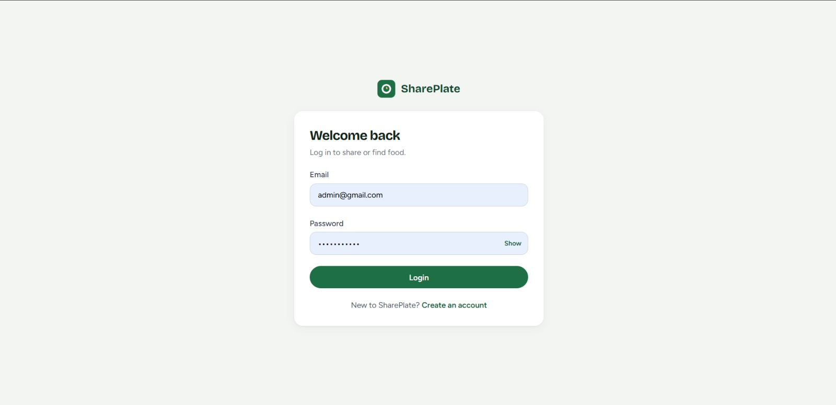
Frontend Implementation
07 • INTERFACE
React.js components and Tailwind CSS layouts support separate donor and recipient experiences.
Main landing page
Login page
Main interface areas: public entry, account access, donor dashboard, recipient dashboard, listing forms and food details.
SHAREPLATE • CODEFORGE BUILDX 2026
08 / 12

Slide 9
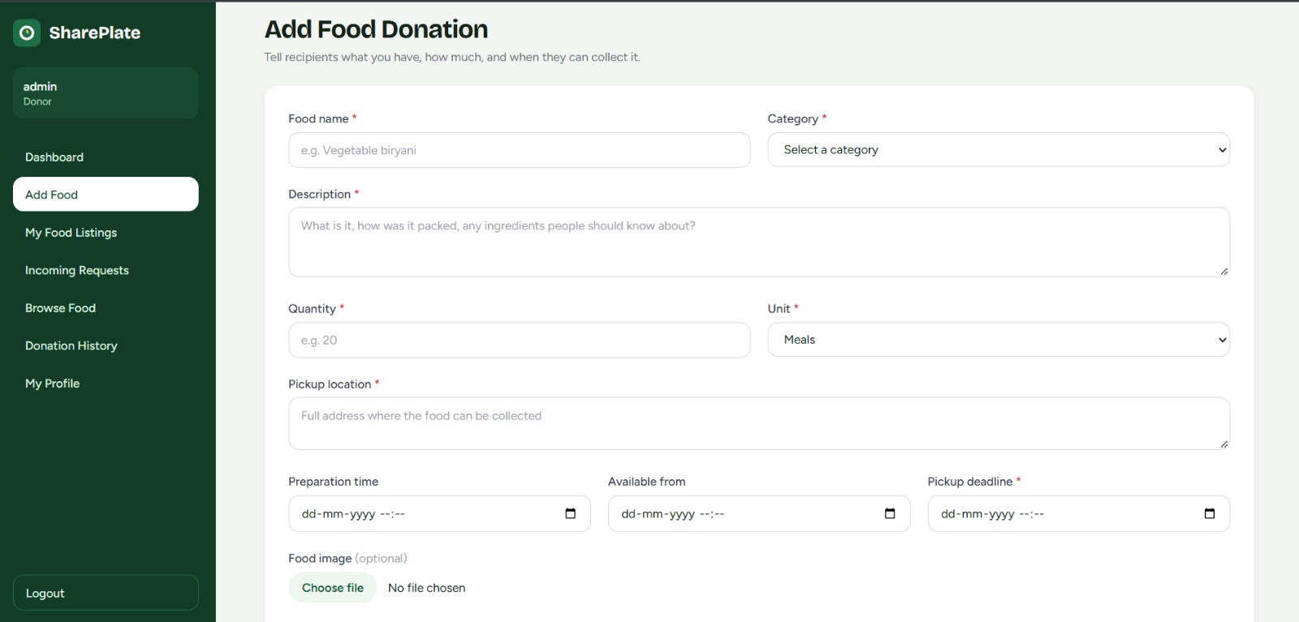
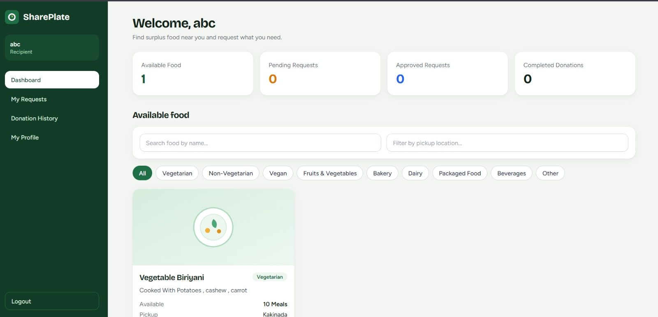
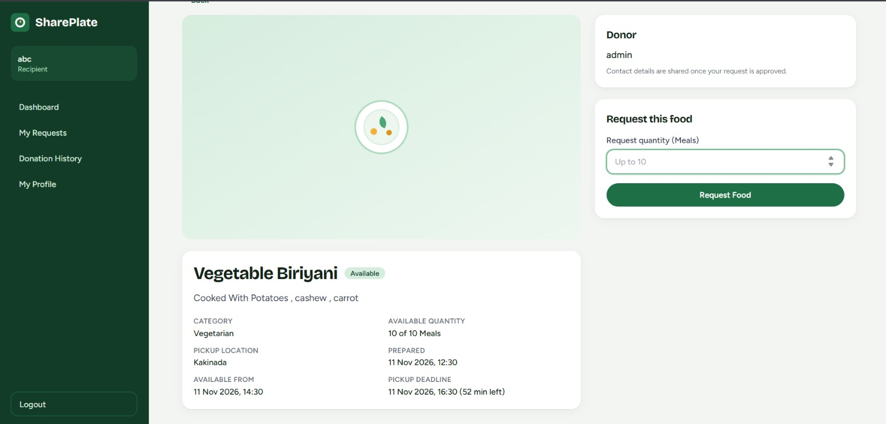
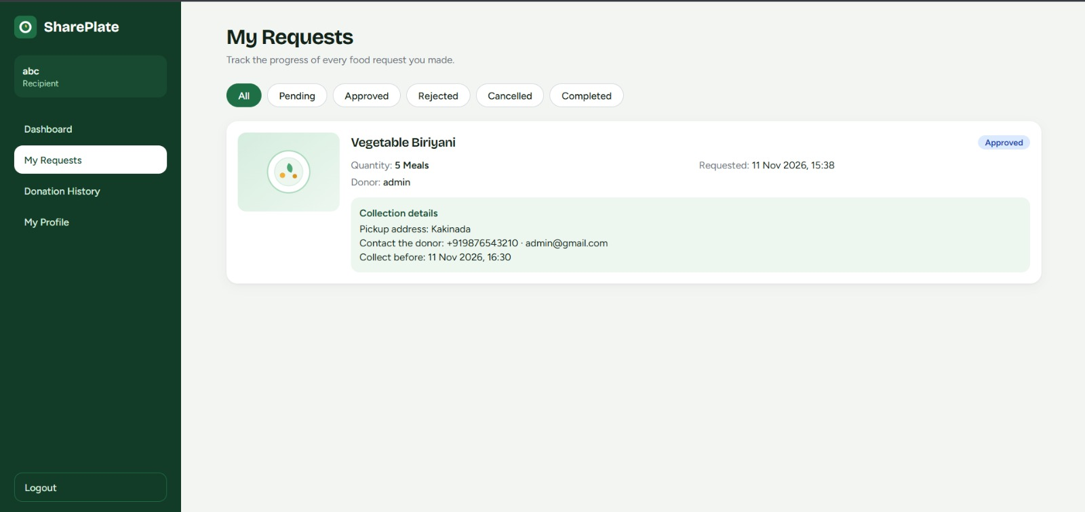
Donation & Discovery Screens
08 • INTERFACE
Add food donation
Available food listings
Food details and quantity request
Recipient request status
SHAREPLATE • CODEFORGE BUILDX 2026
09 / 12

Slide 10
Backend & Database Design
09 • ENGINEERING
Backend: Python + FastAPI
Database: PostgreSQL
• Authentication and user/role handling
• Food listing create, retrieve and update
• Request creation and donor decisions
• Status management and input validation
• Users: donor and recipient accounts
• Food Listings: surplus food published by donors
• Food Requests: quantity-based recipient requests
CORE RELATIONSHIPS
USERS
FOOD LISTINGS
FOOD REQUESTS
user_id (PK)
role • email
food_id (PK)
donor_id (FK)
request_id (PK)
food_id / recipient_id (FK)
Integrity: primary keys, foreign keys, unique email, positive requested quantities and secure password hashes.
SHAREPLATE • CODEFORGE BUILDX 2026
10 / 12

Slide 11
Testing, Results & Limitations
10 • VALIDATION
Testing performed
Reported results
• Valid registration and login
• Donor / recipient role separation
• Create and display food listings
• Browse available food
• Submit quantity-based requests
• Approve / reject requests
• View history and status
The project documentation reports that all listed test cases passed. The application includes donor dashboards, listing management, available-food display, request decisions, history and profile sections.
LIMITATIONS
Food safety, storage and transportation must be verified by people handling each donation.
Real-time notifications, location-based discovery and maps are future additions.
Platform usefulness depends on accurate listings and active participation.
SHAREPLATE • CODEFORGE BUILDX 2026
11 / 12

Slide 12
TEAM, CONCLUSION & NEXT STEPS
TEAM
AI-ASSISTED DEVELOPMENT
Anusha Saladi | 25B11CS839
Ramoju Surya Venkata Sai Prakash | 25B11CS809
Santha Thanuja | 25B11CS855
Kosuri Teja Sampath Vinay | 25B11CS473
Claude AI was used to generate project files and code from the team's requirements. The team organized, connected, configured, integrated, debugged and tested the application.
CONCLUSION
SharePlate demonstrates a digital way to connect surplus-food donors with recipients, organize requests and encourage responsible food utilization.
FUTURE ENHANCEMENTS
Location-based discovery • Real-time notifications • AI-based food matching
Mobile application • Impact tracking • Volunteer coordination
GitHub: github.com/Anushasaladi/Shareplate
THANK YOU
12 / 12

